Slide 1

County Franchise Comparison
Oakland County, MI
Bay County, FL
Prepared by
Varshini Rana
April 19, 2022

Slide 2
Table of Contents
3.
Recommendation: Oakland County, Michigan
4.
Methodology
5.
Oakland Communities for Consideration
6.
Demographics
7.
Personas
8.
Dining Behaviors
9.
Why not Bay County?
10.
Next Steps and Conclusion
12.
References

Slide 3
Recommendation: Oakland County, Michigan
Executive Summary
Background
The Franchise Department of Chicken Kitchen is looking for a new location to expand into based on applications from Oakland County, Michigan and Bay County, Florida. This report seeks to evaluate these locations and recommend one county to expand the franchise into.
Consideration Criteria
Chicken Kitchen experiences high profits in newly-developed locations primed for population growth where dwellers enjoy highway proximity, higher income, lean conservative, prefer to dine-out, and stay near other upscale fast-casual restaurants. These are the criteria to consider in evaluating the two locations.
Recommended Action
Based on these criteria, Oakland County, Michigan seems to be the more promising of the two locations to expand into. Oakland County contains several institutions of higher education (such as Oakland University), ensuring a large and steady influx of young people. The county is very accessible by road, with about 15 major highways passing through, making car culture rampant. The median income of the residents is $81,587, with roughly 40% of them having an income of over $100,000. Oakland County has a wide variety of upscale and budget fast-food restaurants, meaning that the market is pre-primed for expansion. However, the political climate of Oakland county is
rather liberal, with the residents voting Democratic (56.2% in the latest election) for the past 6 Presidential elections spanning a period of 20 years. Moreover, the county has a large population of about 1.27 million with no appreciable increase over the last decade. This still bodes well due to the ample availability of consumers and increasing demand. While housing growth was not substantial over the last 21 years (10.5%), there was still a sizeable number of new housing units added in that period (51,478).
Rejected Option
While Bay County, Florida is strongly conservative (70.9% voting Republican in the last election and voting Republican consistently for the past 6
elections spanning 20 years) and has seen a whopping 36.6% housing growth over the last 21 years, the population is only 179,168 with a projected growth of just 2.2%. Moreover, the median income is on the low side ($56,483), with about 13% of the population living below the poverty line compared to Oakland County’s 7.8%. The lack of universities and major highways also makes this a less favorable location.
Action Steps
1. Conduct focus group discussions.
2. Initiate discussions on available land in college towns such as Rochester Hills and the cost.
3. Have the Research Team run
stats on other fast-casual restaurant competition.
Oakland County is the 21st most wealthy county in the USA.
Historically, Chicken
Kitchen locations in
college towns have an
average profit increase of 1.2% annually over
locations in non-college towns.
Oakland County's knowledge-based economic initiative, "Automation Alley", has developed one of the largest employment centers for engineering and related occupations in the USA.

Slide 4
Methodology
Demographic Data
To evaluate the two counties for potential Chicken Kitchen expansion, demographic data was obtained from the following sources:
The 2021 U.S. Census data from Census.gov compiled by the U.S. Census Bureau
American Community Survey from the U.S. Census from 2020 via CensusReporter.org
2021 estimated and 2026 projected data from Gale Business DemographicsNow
Oakland County, MI government services webpage via OakGov.com
Consumer Data
The following sources were used to create consumer profiles and perform a behavioral analysis on potential patrons of Chicken Kitchen in the two counties:
Simmons consumer data via Gale Business DemographicsNow, which provided insight into the perception of county locals regarding food and entertainment along with their spending habits
Mosaic Experian consumer profiles via Gale Business DemographicsNow, which provide an account of personality types prevalent in each county and shed light on their marketing preferences, typical behaviors, inclinations, and general beliefs
Open Web Research
To gain additional insight into potential local community behaviors, openly-available content was obtained from the following websites:
Google Maps to confirm the presence of major roadways in the counties
Yelp to get a sense of the peers and competition in the area

Slide 5
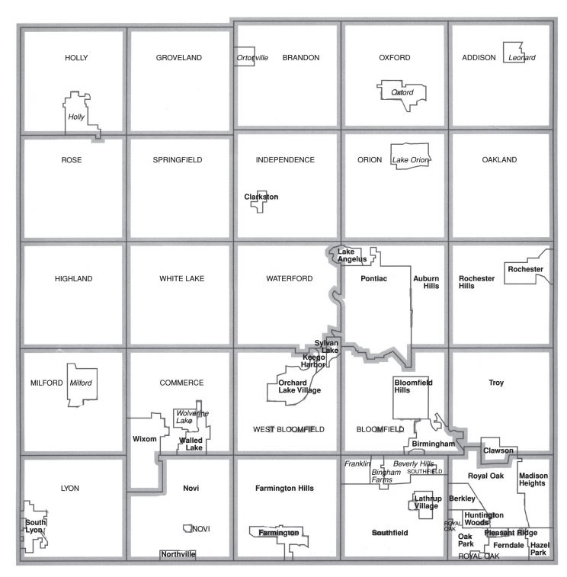
Oakland Communities for Consideration
Oakland County
Oakland County is part of the metropolitan Detroit area, located about 27 miles north-west of Detroit. As of the 2021 U.S. Census (U.S Census Bureau, 2021), the population of the county is 1,270,017, making it the second-most populous county in Michigan after Wayne County. As many as 15 major interstate, numbered, and trunkline highways pass through Oakland County, connecting it seamlessly with major cities. Oakland County even houses the Oakland County International Airport in Waterford Township. Moreover, Oakland County is located just 34 miles away from the larger Detroit Metropolitan Airport. This underpins Oakland County’s status as a prime location for Chicken Kitchen expansion, ensuring that both residents as well as out-of-towners can benefit from these services.
Initial Proposed Location: Rochester Hills
Rochester Hills bears a close proximity to the city of Detroit, which is just 12 miles south of it. Rochester Hills is home to the Oakland University and the Rochester University, making it a booming college city seeing a large and steady influx of young people all year-round.
Future Expansion: Pontiac
Pontiac is the county seat of Oakland County. The city is well-known as an automobile hub, having housed several General Motors automobile manufacturing plants which greatly contributed to its wealth and economy. Pontiac has several major thoroughfares passing through it, as well as a thriving rail service and close proximity to airports, making it an ideal location for future expansion of Chicken Kitchen within Oakland County.
Future Expansion
Initial Location
Map of Oakland County Municipalities showing Initial Location (proposed) and Future Expansion of Chicken Kitchen within Oakland County
Image Source: Oakland County, Michigan (OakGov.org)

Slide 6
Demographics
Population
The significant 1.27 million population of Oakland County (U.S. Census Bureau, 2021) definitely bodes well for the advent of Chicken Kitchen, which is poised to keep up with the increasing demand for high-quality, freshly-prepared, healthy, and quick meal options. In a world of multitudes, Chicken Kitchen has achieved great success in accommodating varied dietary preferences and tailoring product portfolios to suit diverse tastes and preferences, which makes its expansion into Oakland County a welcome prospect.
Income
According to CensusReporter.org, Oakland County has a per capita income of $46,075, which is 1.3 times the amount in the U.S. ($35,384); a median household income of $81,587, which is 25% higher than the amount in the U.S. ($64,994); and a median value of owner-occupied housing units of $252,800, which is 10% higher than the amount in the U.S. ($229,800). Gale Business DemographicsNow predicts a further 16.3% growth in median household income and 14.1% growth in per capita income of Oakland County Residents by 2026. The relatively high income and high prices of housing units in Oakland County compared to the U.S. as a whole point to a fairly affluent and economically-stable consumer base, which fits with Chicken Kitchen’s target demographics.
Value (in U.S.D.)
Data Source: CensusReporter.org

Slide 7
Personas The Right Customers for Chicken Kitchen
Personas are tools to create behavioral profiles of potential customers. They are useful in characterizing a target demographic by getting an impression of the typical behaviors they exhibit, their habits, their preferences, and their values. The top 5 personas described below were created by Mosaic Experian, based on the demographic makeup of Oakland County. Chicken Kitchen typically does well in communities where residents are well off, have busy and active lifestyles while being health-conscious, and have conservative leanings.
Booming with Confidence
Prosperous, established couples in their peak earning years living in suburban homes with sophisticated and conservative tastes.
Power Elite
The wealthiest households in the US who tend to be health-conscious and invest a lot in diet and exercise.
Flourishing Families
Affluent, middle-aged families living active lifestyles and having conservative leanings.
Suburban Style
Middle-aged, ethnically-mixed suburban families who have a “work hard, play hard” mentality and earn upscale incomes.
Singles and Starters
Young singles and starter families who enjoy the city life along with all its trappings, stay fit and active, and eat out a lot.
Booming with
Confidence
Others
Singles
and
Starters
Power Elite
Suburban
Style
Flourishing
Families
Data Source: Mosaic Experian via Gale Business DemographicsNow

Slide 8
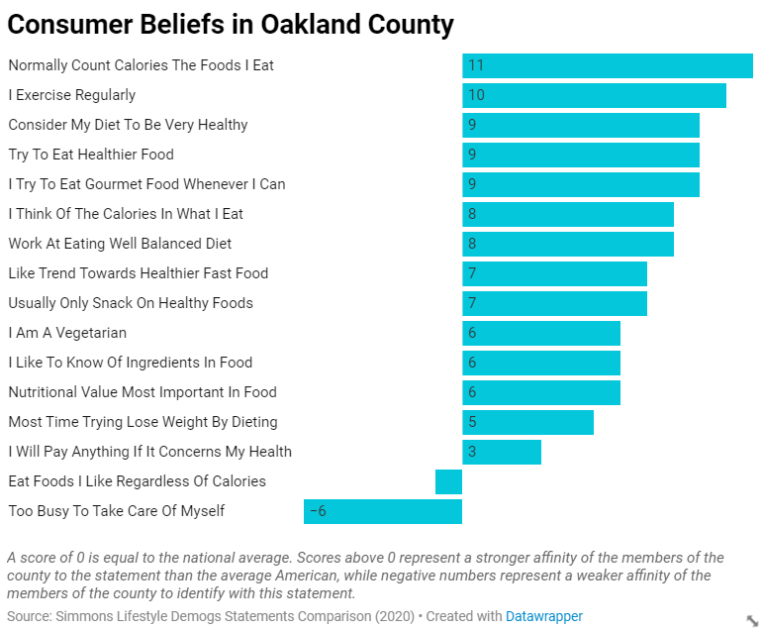
Dining Behaviors
According to the Simmons Lifestyle Demographics Statements Summary which makes use of indices where the number 100 represents the average American, Oakland County residents rate above the average American for a number behavioral statements which favor Chicken Kitchen expansion, including but not limited to “Normally Count Calories The Foods I Eat” (11 above the average American), “Consider My Diet To Be Very Healthy” (9 above the average American), and “Like Trend Towards Healthier Fast Food” (7 above the average American). They also scored 1 point below the average American for “Eat Foods I Like Regardless of Calories” and 6 points below the average American for “Too Busy To Take Care Of Myself”, suggesting a strong health-conscious leaning.
These traits seem to be a perfect fit for Chicken Kitchen’s approach to clean ingredients and healthy fast-casual dining.
Based on a quick survey of Yelp, other upscale fast-casual restaurants which promote healthy dining options, such as Panera Bread, Popeyes Louisiana Kitchen, Chick-fil-A, and Chipotle Mexican Grill are already thriving in Oakland County, depicting a market that is pre-primed for Chicken Kitchen expansion. There is also a wide variety and number of budget fast-food options such as McDonald’s and Burger King, suggesting that the fast-food market is booming in this county even with lower quality options.
-1

Slide 9
Why not Bay County?
The alternative franchise application was received from Bay County, Florida. Bay County has a few advantages over Oakland County, such as:
A strongly conservative population with 70.9% voting Republican in the last election and voting Republican consistently for the past 6 elections spanning 20 years (OakGov.com)
A housing growth of 36.6% over the last 21 years (Gale Business DemographicsNow)
However, it severely lacks in numerous other criteria deemed essential for the Chicken Kitchen franchise to thrive, such as:
The population is only 179,168 with a projected growth of just 2.2% by 2026 (Gale Business DemographicsNow)
The per capita income ($30,774), the median household income ($56,483), and the median housing unit value ($195,000) are all on the low side compared to the national equivalents (CensusReporter.org)
​Higher poverty rate compared to Oakland County, with 13% of residents living below poverty line compared to Oakland County’s 7.2% (CensusReporter.org)
​​Lack of cultural fit based on personas, with most personas in the county belonging to middle- or lower-middle class socio-economic statuses and preferring budget fast-food options (Mosaic Experian)
​Lack of universities and major highways passing through (Google Maps)
Oakland County, MI
Households by Income greater than $100,000 (in percent)
Bay County, FL
Data Source: Gale Business DemographicsNow

Slide 10
Next Steps and Conclusion
As underpinned by this report, it is recommended that Oakland County, Michigan be selected for Chicken Kitchen expansion. Oakland County’s population, high income, leanings towards high budget expenditures, proximity to major roadways, and cultural fit seem to complement Chicken Kitchen’s model of healthy fast-casual dining for patrons who do not mind paying a few dollars more for higher quality fast-food. The following are the recommended action steps:
1. Conduct focus group discussions
Given the prevalence of a booming fast-food market in the county, it would be worthwhile to conduct Focus Group discussions to determine whether Chicken Kitchen would be well-received and to get a sense of whether the market is saturated precluding further growth. Focus Groups also provide direct, invaluable customer feedback.
2. Initiate real estate discussions
Initiate discussions on availability and costs associated with land and personnel in college cities such as Rochester Hills. Proximity to Detroit might have the consequence of disproportionately high land costs, which need to be taken into consideration by means of a Break-Even Analysis.
3. Research on other fast-casual competitors
Oakland County has several fast-casual dining destinations (and dozens of branches of each all over the county), such as Panera Bread, Popeyes Louisiana Kitchen, Chick-fil-A, and Chipotle Mexican Grill, each well-known for having a similar business model to that of Chicken Kitchen. Further market analysis needs to be conducted to determine the possibility of market saturation in this county.

Slide 11
All ways,
moving forward…
— Oakland County, MI Government Services Web Page (OakGov.com)

Slide 12
References
“American Community Survey”. 2020. Census Reporter: Making Census Data Easy to Use. https://censusreporter.org/
“U.S. Census Bureau QuickFacts: Oakland County”. 2021. The United States Census Bureau. https://www.census.gov/quickfacts/oaklandcountymichigan
“U.S. Census Bureau QuickFacts: Bay County”. 2021. The United States Census Bureau. https://www.census.gov/quickfacts/baycountyflorida
“Oakland County, MI”. 2021. Gale Business: DemographicsNow. https://www.gale.com/c/business-demographicsnow
“Bay County, FL”. 2021. Gale Business: DemographicsNow. https://www.gale.com/c/business-demographicsnow
“Oakland County, Michigan”. 2021. Oakland County, Michigan Government Services. https://www.oakgov.com/Pages/default.aspx
“Yelp”. 2022. Yelp. https://www.yelp.com
“Google Maps”. 2022. Google Maps. https://www.google.com/maps

